Slide 1

PROGNOSTIC SIGNIFICANCE OF THE NEUTROPHIL/LYMPHOCYTE RATIO IN PERPHERAL T-CELL LYMPHOMA: A SYSTEMATIC REVIEW AND META-ANALYSIS
Rafael Pichardo-Rodriguez, Liz B Cordova-Cueva, Dante M. Quiñones-Laveriano, Susy Bazán-Ruiz, Brady E. Beltrán-Gárate, Jhony A De La Cruz-Vargas
¹ Unidad de Análisis y Generación de Evidencia (UAGEV). Instituto de Investigaciones en Ciencias Biomédicas (INICIB). Universidad Ricardo Palma, Lima-Perú.
² Escuela de Medicina, Universidad César Vallejo, Piura, Perú

Slide 2

Background
Peripheral T-Cell Lymphoma (PTCL): A rare but aggressive form of non-Hodgkin lymphoma affecting T-cells. Hematological malignancy with distinct pathological features.
  Prevalence: Accounts for ~15% of all non-Hodgkin lymphomas.
  Mortality: High mortality rate with current treatment regimens.
  Treatment Challenges: Heterogeneous disease, making standardized treatment difficult. Need for prognostic markers.
Neutrophil-to-Lymphocyte Ratio (NLR): An emerging prognostic biomarker in various cancers. May predict survival outcomes and treatment responses in PTCL.
Perry AM, Diebold J, Nathwani BN, MacLennan KA, Müller-Hermelink HK, Bast M, Boilesen E, Armitage JO, Weisenburger DD. Non-Hodgkin lymphoma in the developing world: review of 4539 cases from the International Non-Hodgkin Lymphoma Classification Project. Haematologica. 2016 Oct;101(10):1244-1250. doi: 10.3324/haematol.2016.148809. Epub 2016 Jun 27. PMID: 27354024; PMCID: PMC5046654.
Cai W, Zeng Q, Zhang X and Ruan W (2021) Trends Analysis of Non-Hodgkin Lymphoma at the National, Regional, and Global Level, 1990–2019: Results From the Global Burden of Disease Study 2019. Front. Med. 8:738693. doi: 10.3389/fmed.2021.738693

Slide 3
Objective
To present a systematic review and meta-analysis on the prognostic value of NLR in PTCL

Slide 4
Methods - Databases and Criteria
Systematic search of the literature until July 2023
Databases: PUBMED, EMBASE, SCOPUS.
Inclusion Criteria:
  Study Design: Prospective and retrospective longitudinal cohort studies
  Diagnostic Criteria: WHO criteria for PTCL diagnosis
  Outcome Measures: Overall Survival (OS) and Progression-Free Survival (PFS).
  Baseline Measures: Studies must measure NLR prior to treatment initiation

Slide 5
Methods - Data Extraction and Quality Assessment
Two Reviewers: Studies selected independently by two reviewers to minimize bias.
Data Extraction: Focused on clinical characteristics, NLR values, Hazard Ratios (HR), and 95% Confidence Intervals (95% CI).
Quality Assessment: Employed the Newcastle-Ottawa Scale for evaluating the quality and potential bias of included studies.

Slide 6
Methods – Meta analysis
Quality-verified data underwent meta-analysis.
Influence analysis: Leave-one-out method.
Meta-regression: Impact of <200 sample size on heterogeneity.
Primary endpoints: Overall Survival (OS) and Progression-Free Survival (PFS).

Slide 7
Results - Overview
13 studies, 1,825 patients identified.
3 studies from Latin America.
Median NLR was 3.8.

Slide 8
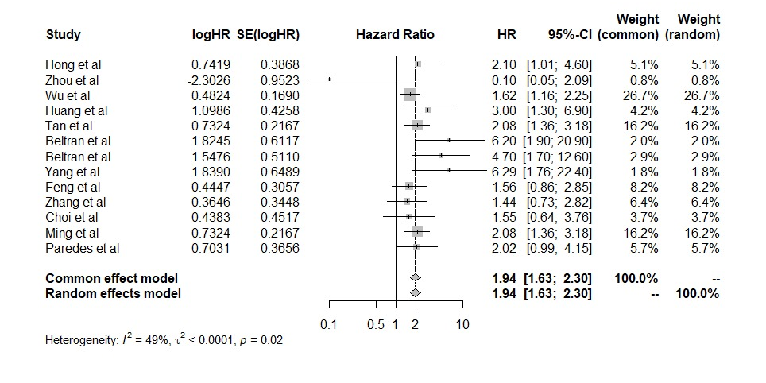
Results - Overall Survival (OS)
Figure 1. Meta analysis of the prognostic significance of the NLR in OS.

Slide 9
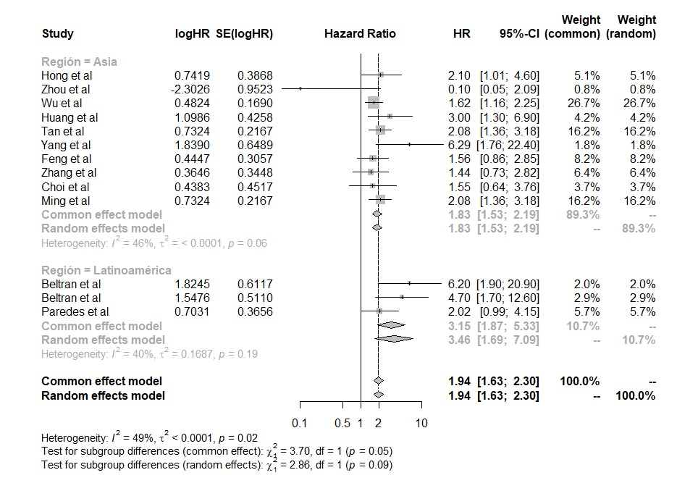
Figure 2. Subgroup meta analysis by region of the prognostic significance of the NLR in OS.

Slide 10
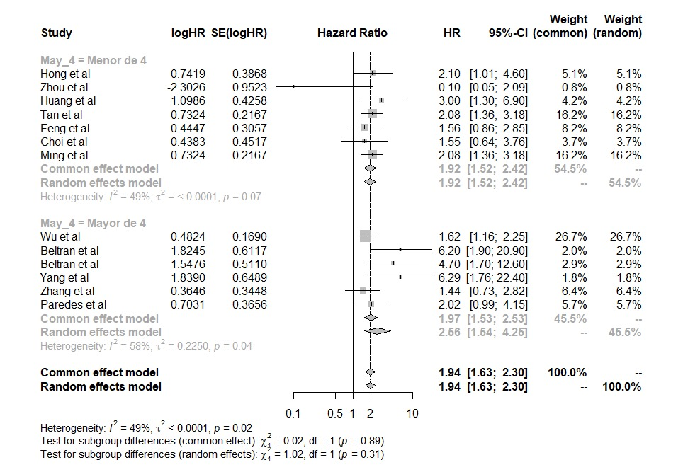
Figure 3. Subgroup meta analysis of the prognostic significance of the NLR>4 in OS.

Slide 11
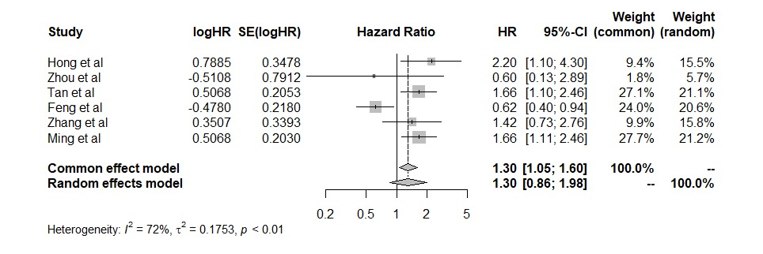
Results - Progression-Free Survival (PFS)
Figure 4. Meta analysis of the prognostic significance of the NLR in PFS.

Slide 12
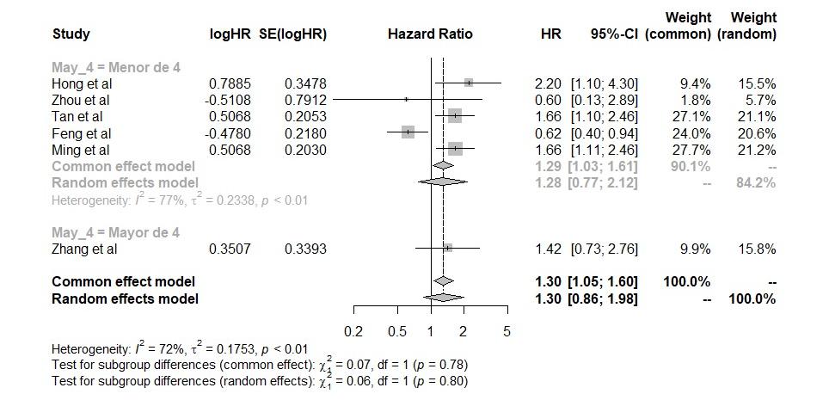
Figure 6. Subgroup meta analysis of the prognostic significance of the NLR>4 in FPS.

Slide 13
Results – Heterogeneity and Bias
Excluding Zhou et al. study in OS analysis:
Reduced heterogeneity (I2: 20%; p<0.01)
Unchanged effect size (HR: 1.9 [95% CI: 1.6-2.3])
Excluding Feng et al. Study in PFS analysis:
Reduced heterogeneity (I2: 0%; p>0.05)
Increased effect size (HR: 1.6 [95% CI: 1.2-2.1])
Meta regression:
A sample size <200 did not have an impact on heterogeneity.

Slide 14
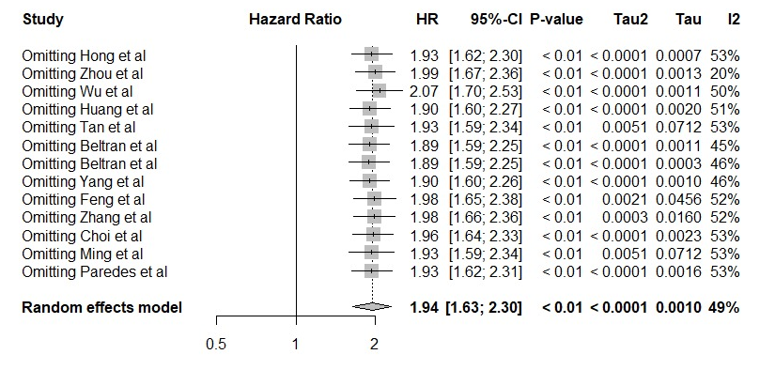
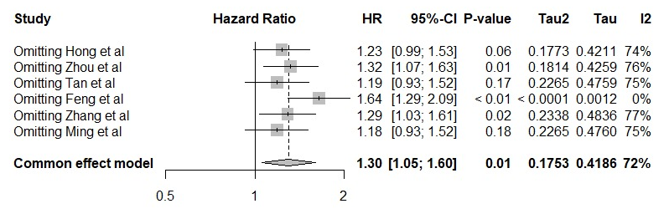
Figura 7 and 8. Influence analysis for OS and FPS.

Slide 15
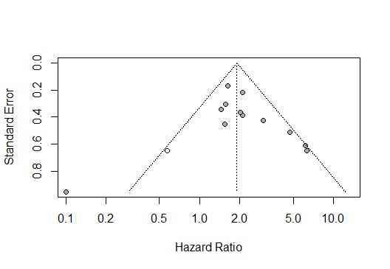
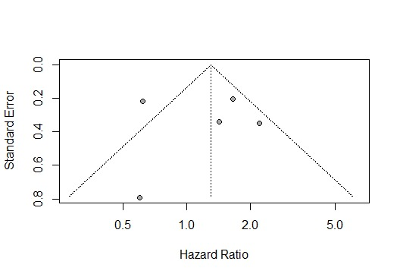
Egger test: 0.6
Egger test: Not evaluated
Figura 9 and 10. Publication bias analysis for OS and FPS.

Slide 16
Discussion - Key Findings
Neutrophil-to-Lymphocyte Ratio (NLR) is a significant prognostic factor for Overall Survival (OS) in Peripheral T-Cell Lymphoma (PTCL).
Higher NLR values (>4) are particularly concerning for LATAM patients.
No significant association between NLR and Progression-Free Survival (PFS).

Slide 17
Discussion – Implications
NLR could serve as a cost-effective and readily available biomarker.
The impact of NLR on OS is notably different in Latin America and Asia, calling for additional research to understand regional disparities.
Standardization of NLR cut-off values is needed for more reliable interpretation across studies.
More studies needed to explore the relationship between NLR and PFS

Slide 18

THANK YOU
GRACIAS
AÑAY WAYQEYPANAYKUNA

